Slide 1
Plotting in Matlab

Slide 2
Plotting
Basic plot types and commands
Formatting and labeling plots
Saving plots
  File formats
  Importing plots into documents
Using the plotting GUI

Slide 3
Basic plot types and commands
Basic plot types:
  plot
  plot3
  bar
Basic plotting commands:
  hold
  figure
  several other useful commands

Slide 4
plot: x-y plots
The “plot” function is the simplest type of plot to produce in Matlab
Example: a 400 X 3 (400 rows of data in three columns) in a Matlab variable called Response.
  Time is in column 1
  Input data is in column 2
  Output data is in column 3
You can give Matlab as many sets of x-y data as you like
plot(Response(:,1),Response(:,2),Response(:,1),Response(:,3))
  In the above line note that the x data is repeated for column 3 and column 1
Format must be in x-y pairs
    plot(xdata,ydata,xdata,ydata…)
x data (time)
y data (input)
x data (time)
y data (output)

Slide 5
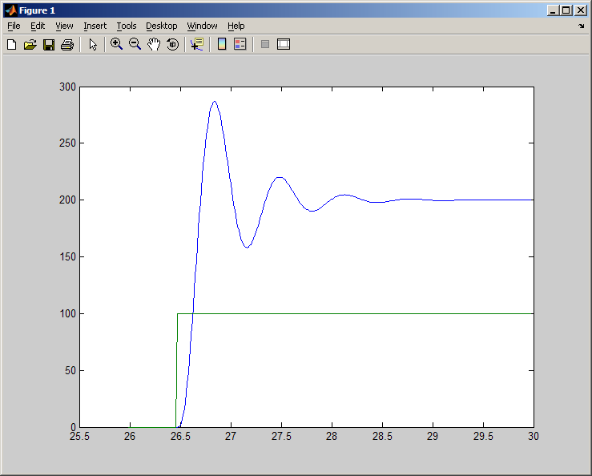
Sample x-y plot
>> plot(Response(: ,1),Response(: , 2),Response(: , 1),Response(: , 3))

Slide 6
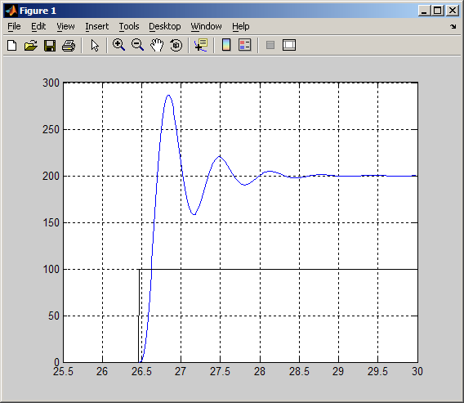
Formatting plots
putting grid lines on the plot
  grid on
limiting axes
  Determine current limits:
  xlim
  returns current x axis limits
  Apply new limits: xlim([27,29]) %would limit x axis between 27 and 29
  ylim is similar for the y axis

Slide 7
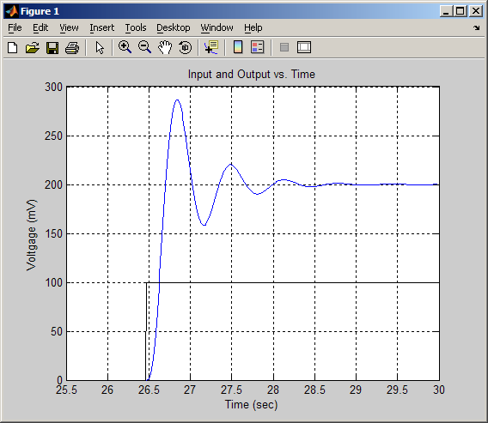
Formatting plots
axis labels
  xlabel(‘x axis label’)
  ylabel(‘y axis label’)
titles
  title(‘Title of Plot’)

Slide 8
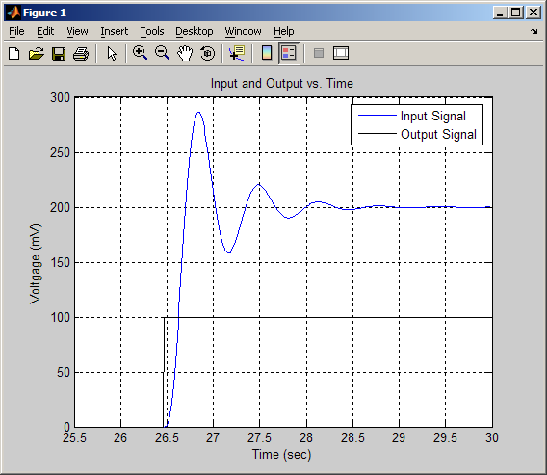
Formatting plots
Use legend to add a legend block
  legend(‘first series label’,’second series label’,…)

Slide 9
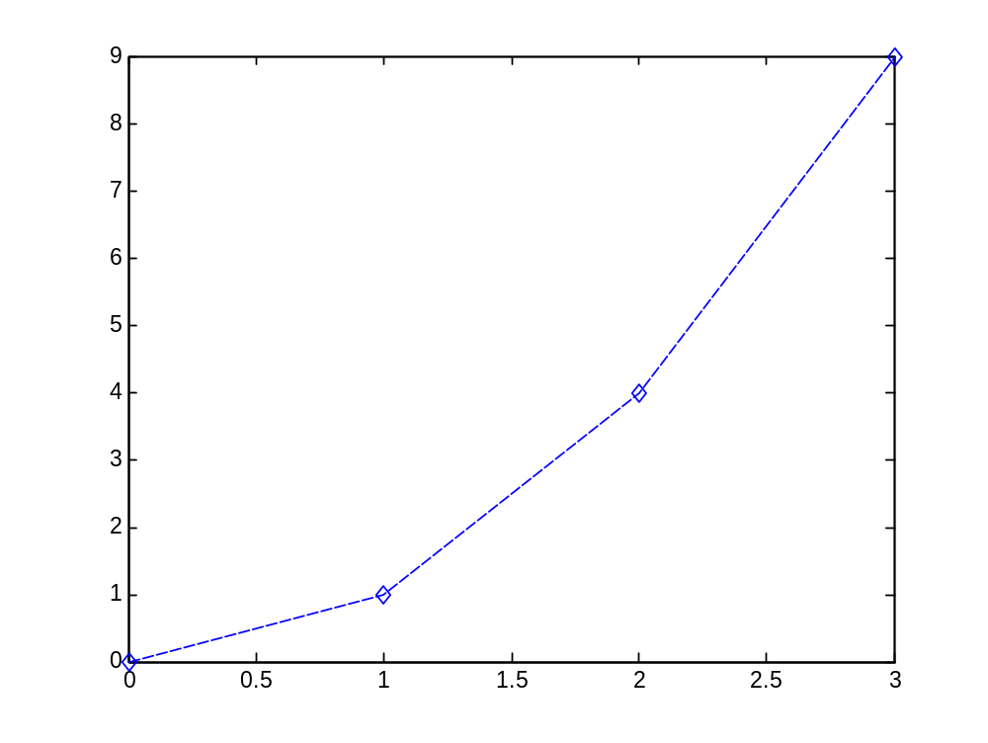
Formatting plot styles
Plotting styles can be controlled
plot(x,y,’--db’)
  plots x,y values with
  -- for dashed lines
  d for diamond markers
  b for blue in color
  (see next pages for details)

Slide 10

Formatting plots line styles
Line Styles

Slide 11
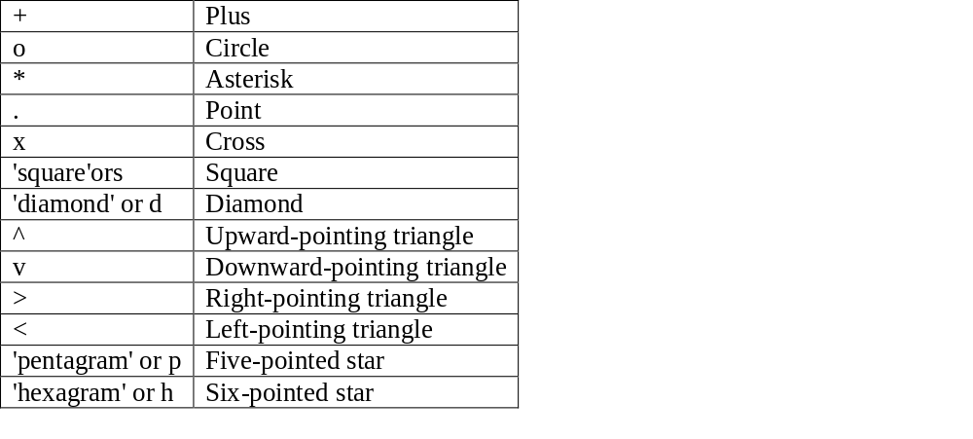
Formatting plots line and marker styles
Marker Specifiers

Slide 12

Formatting plots colors
Color Specifiers

Slide 13
Overlay for Plots
Multiple plots can be put on top of one another using ‘hold on’ and ‘hold off’ commands
  To plot x vs. y and x vs. z use:
  plot(x,y)
  hold on %this keeps the old plot
  plot(x,z)
  hold off %the next plot will overwrite
  this plot

Slide 14
Creating Multiple Plot Windows
Multiple plots can created using the ‘figure’ command
  figure(1) %the next plot will be in window one
  plot(x,y)
  figure(2) %the next plot will be in window two
  plot(x,z)
  figure(1) %the next plot will replace the first plot
  plot(y,z)

Slide 15
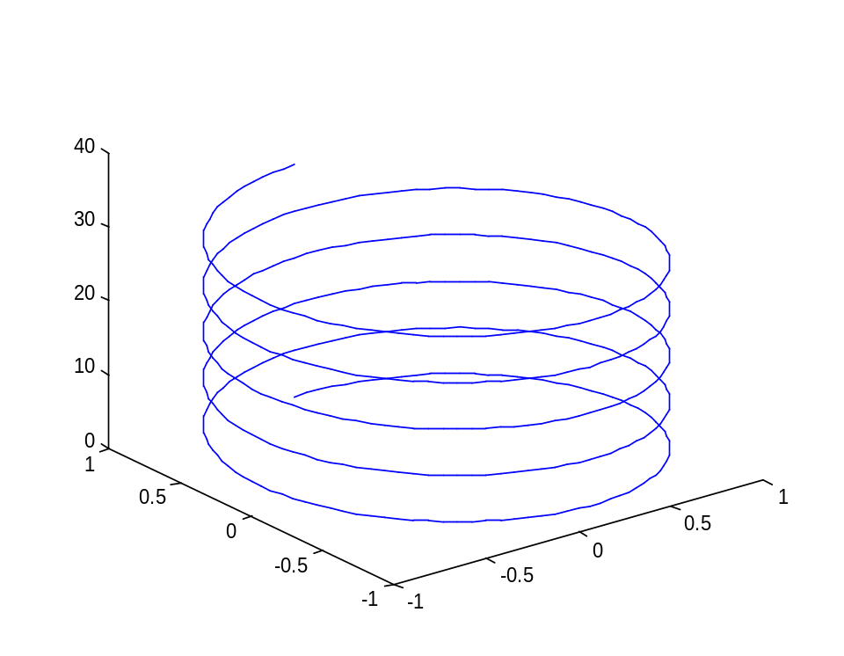
Creating 3-D Plots
The plot3 command plots in 3 dimensional space
%plot a helix
t = 0:pi/50:10*pi; plot3(sin(t),cos(t),t);
The plot can be rotated in 3-D by using the figure toolbar

Slide 16
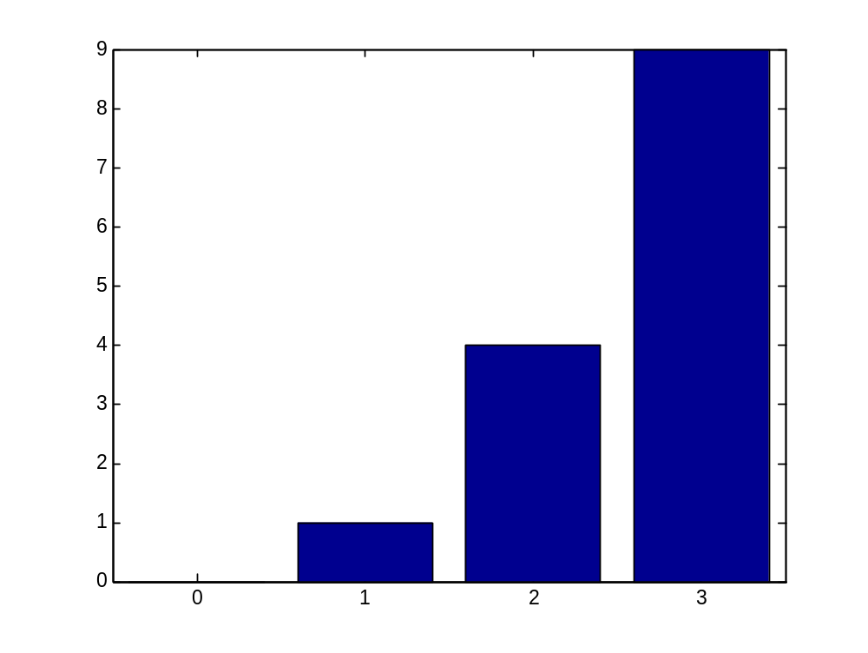
Creating Bar Plots
The bar command plots a bar graph
bar(x,y)

Slide 17
Saving plots
There are a number of ways to save a plot
  From the individual figure window on the file menu (can save as many types bmp, jpg, …)
  From the workspace, using saveas command

Slide 18
Saving plots
saveas
saveas(i, ‘filename’, ‘bmp’)
file formats (for complete list—help saveas)
  bmp, eps, jpg, tif, fig
figure number
plot filename
file format in which to save the plot

Slide 19
Copy a Plot onto the Clipboard
From the figure window select Edit/Copy Figure
The Figure can now be pasted into Word or other documents

Slide 20
Using the Plotting GUI
The plotting Graphical User Interface has many capabilities, more than we will describe here but start by locating
Icons – ZoomIn, ZoomOut, Pan, Rotate 3-D
‘Edit/Axis Properties…’
‘Insert’ Options
‘Tools/Basic Fitting’
‘Tools/Data Statistics’

Slide 21
Plotting Exercise

